Slide 1
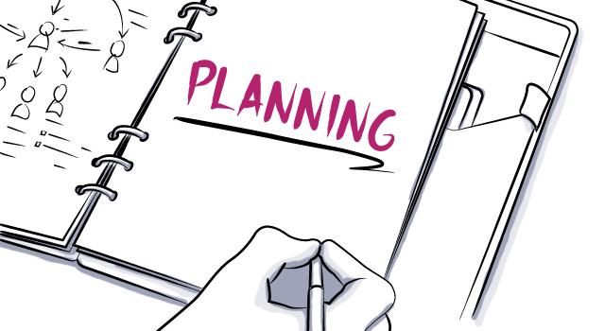
Belbins Test
Concept Map
Risk Analysis
Trello Board
Work Breakdown Structure
Gantt Chart
Pert Diagram
Circle Labs

Slide 2
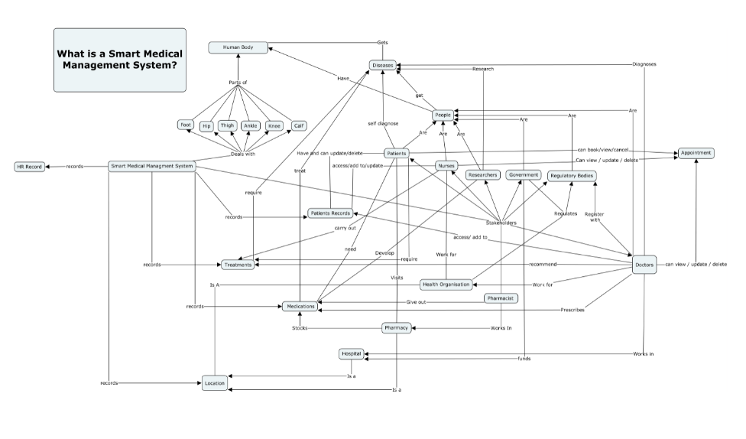
Concept Map / Trello Board
https://trello.com/b/om8BXdCQ/circle-labs

Slide 3
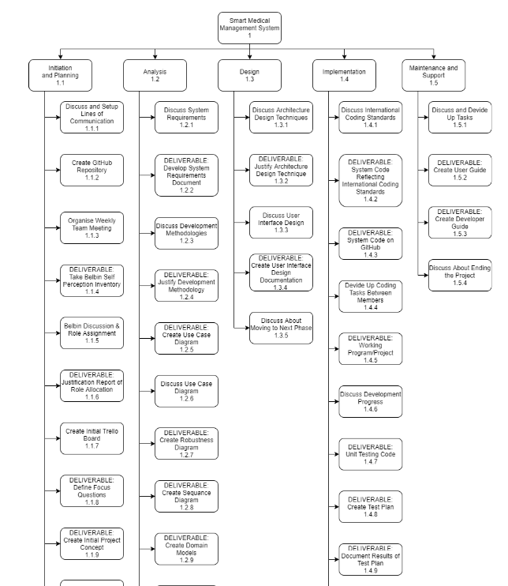
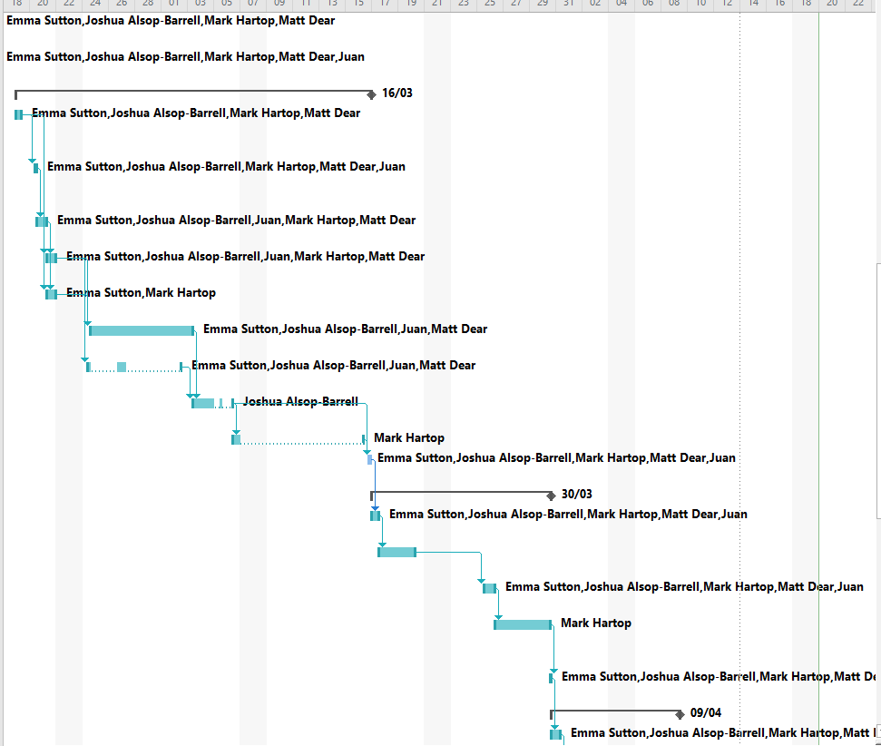
Work Breakdown Structure / Gantt Chart

Slide 4

System Requirements
Methodology
Use Case Diagram
Robustness Diagram
Sequence Diagram
Class Diagram
Domain Model

Slide 5
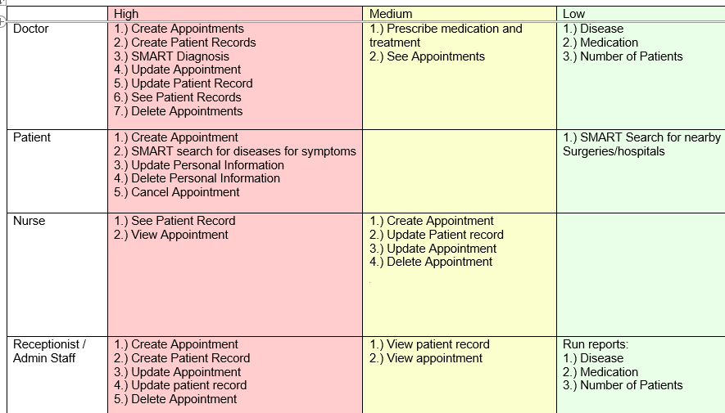
System Requirements:

Slide 6
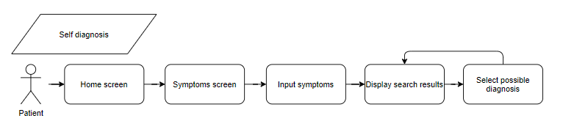
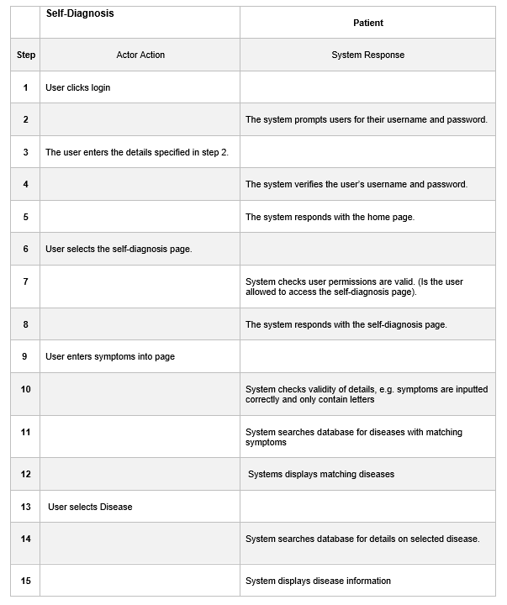
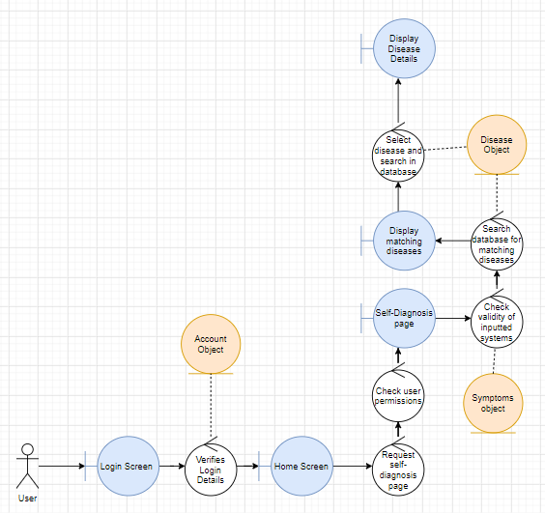
Diagrams:
After
Before
After

Slide 7
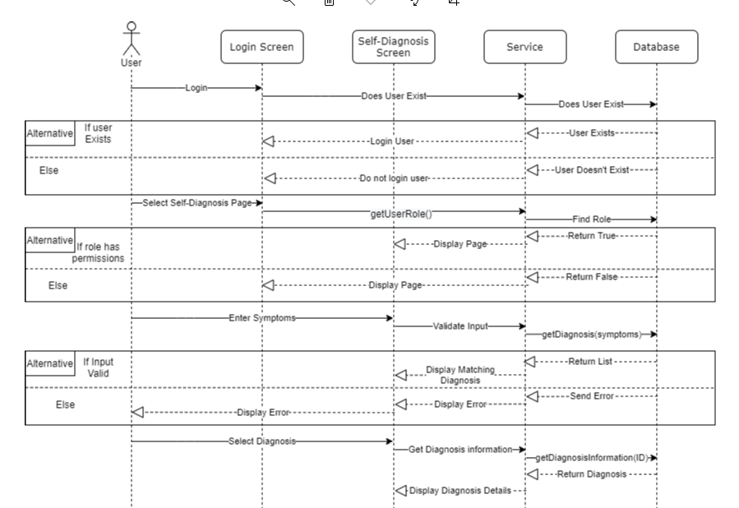
Self Diagnosis

Slide 8

Architecture Design
User Interface Design
Notes:
The next stage is the design stage where we created our GUI and architecture design.

Slide 9
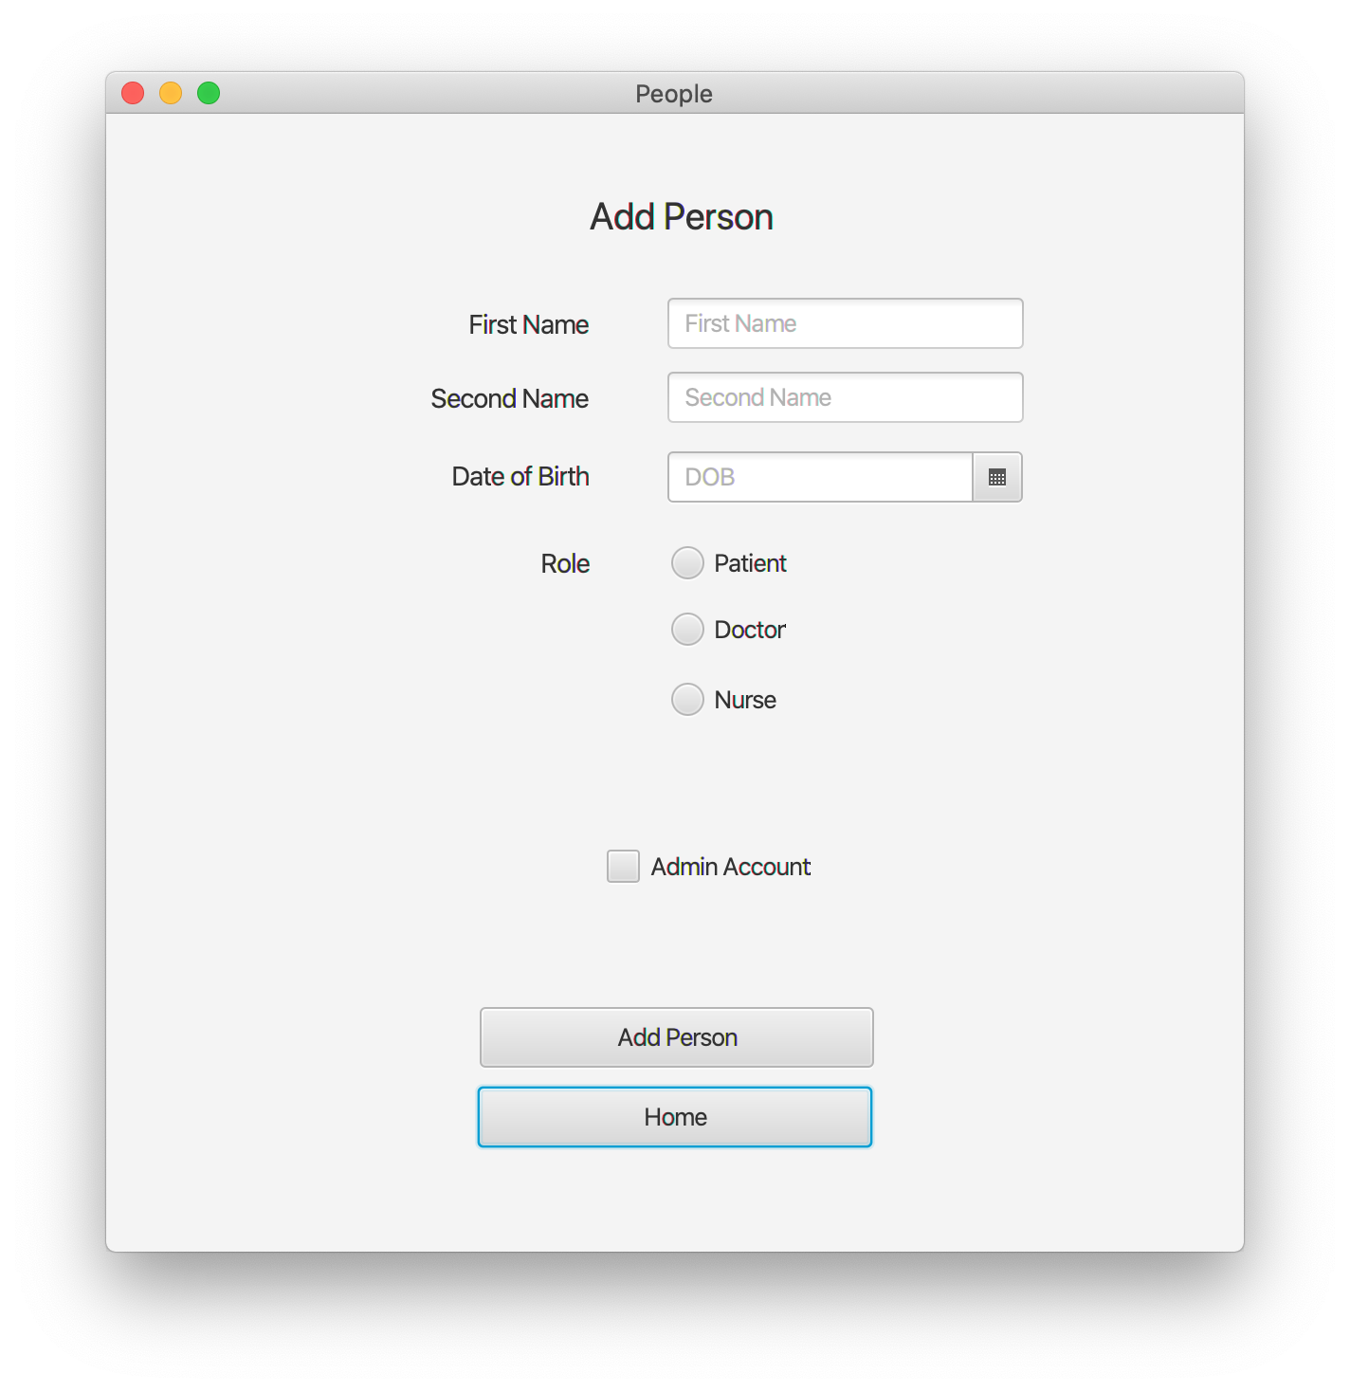
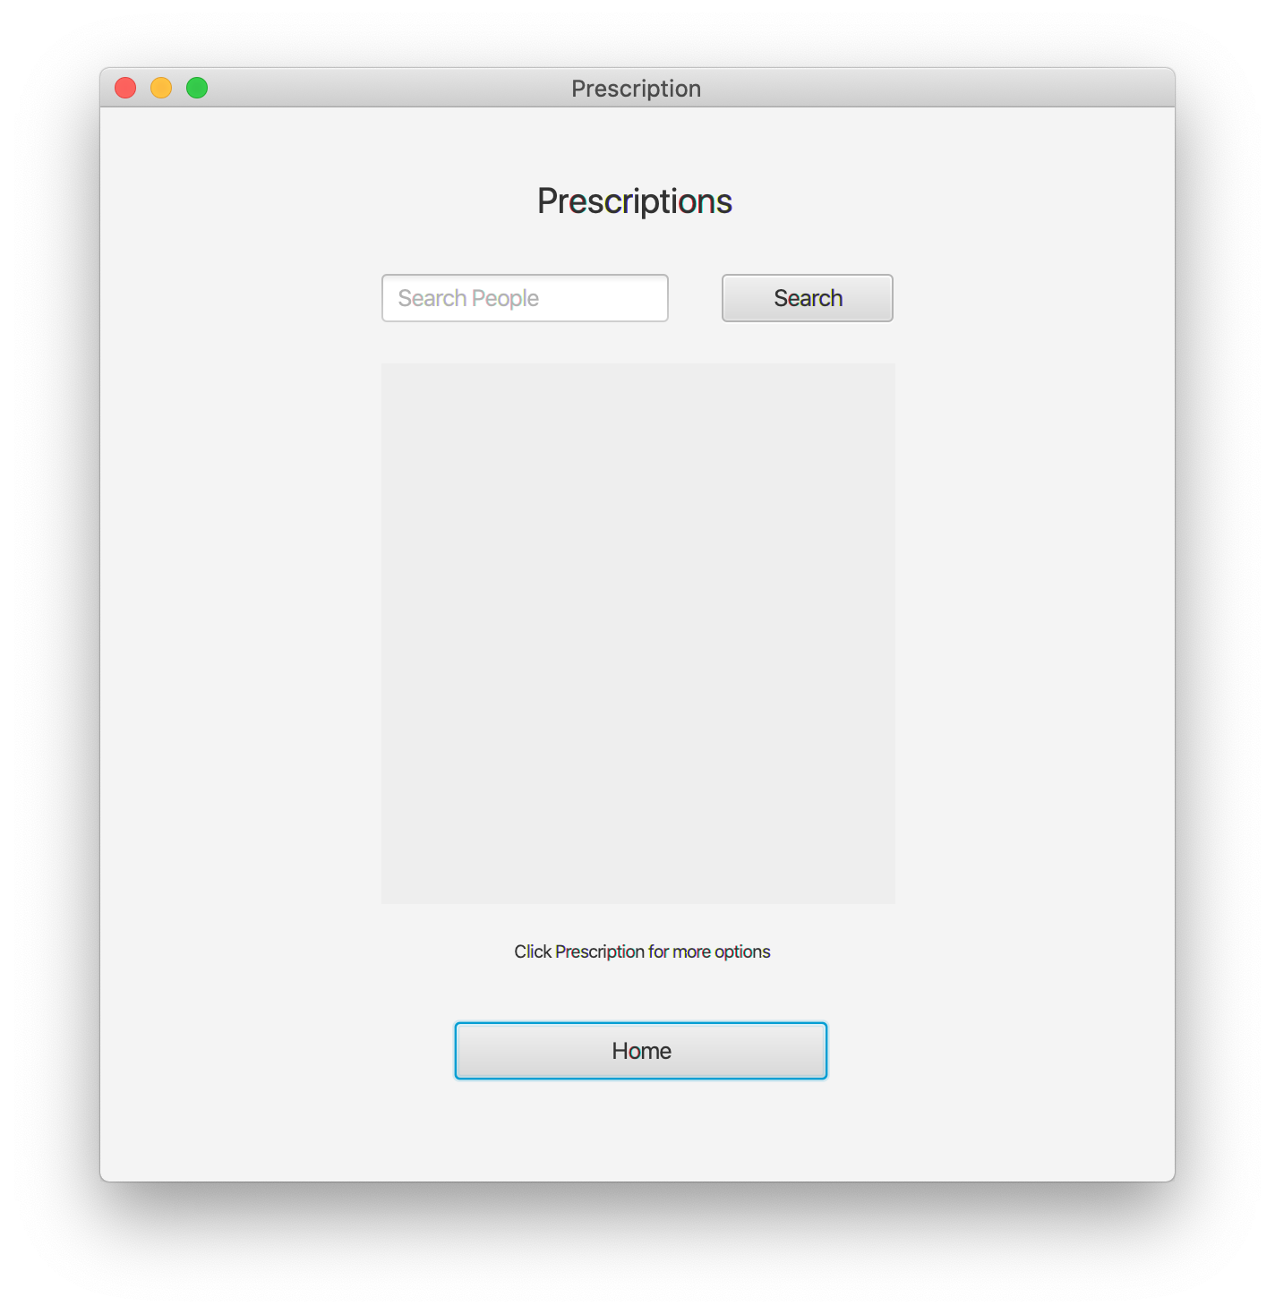
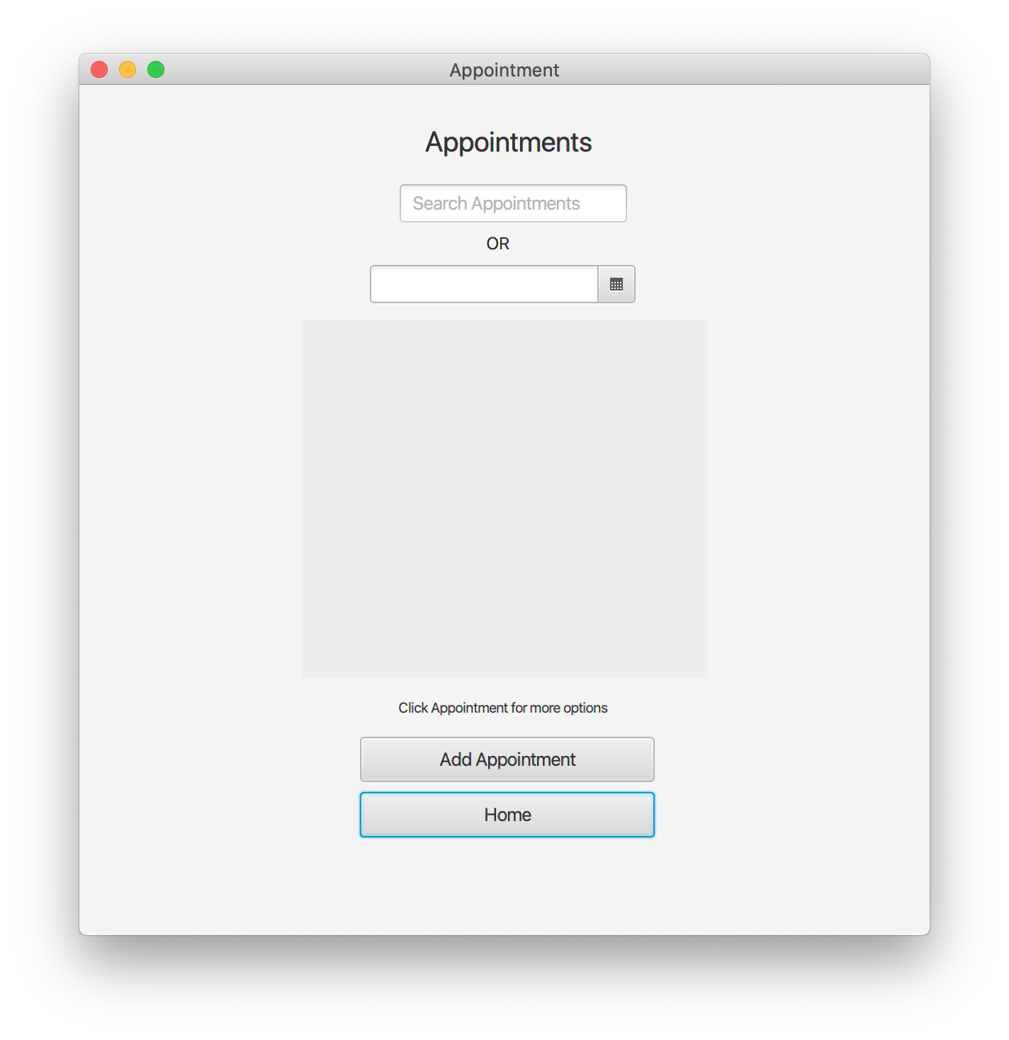
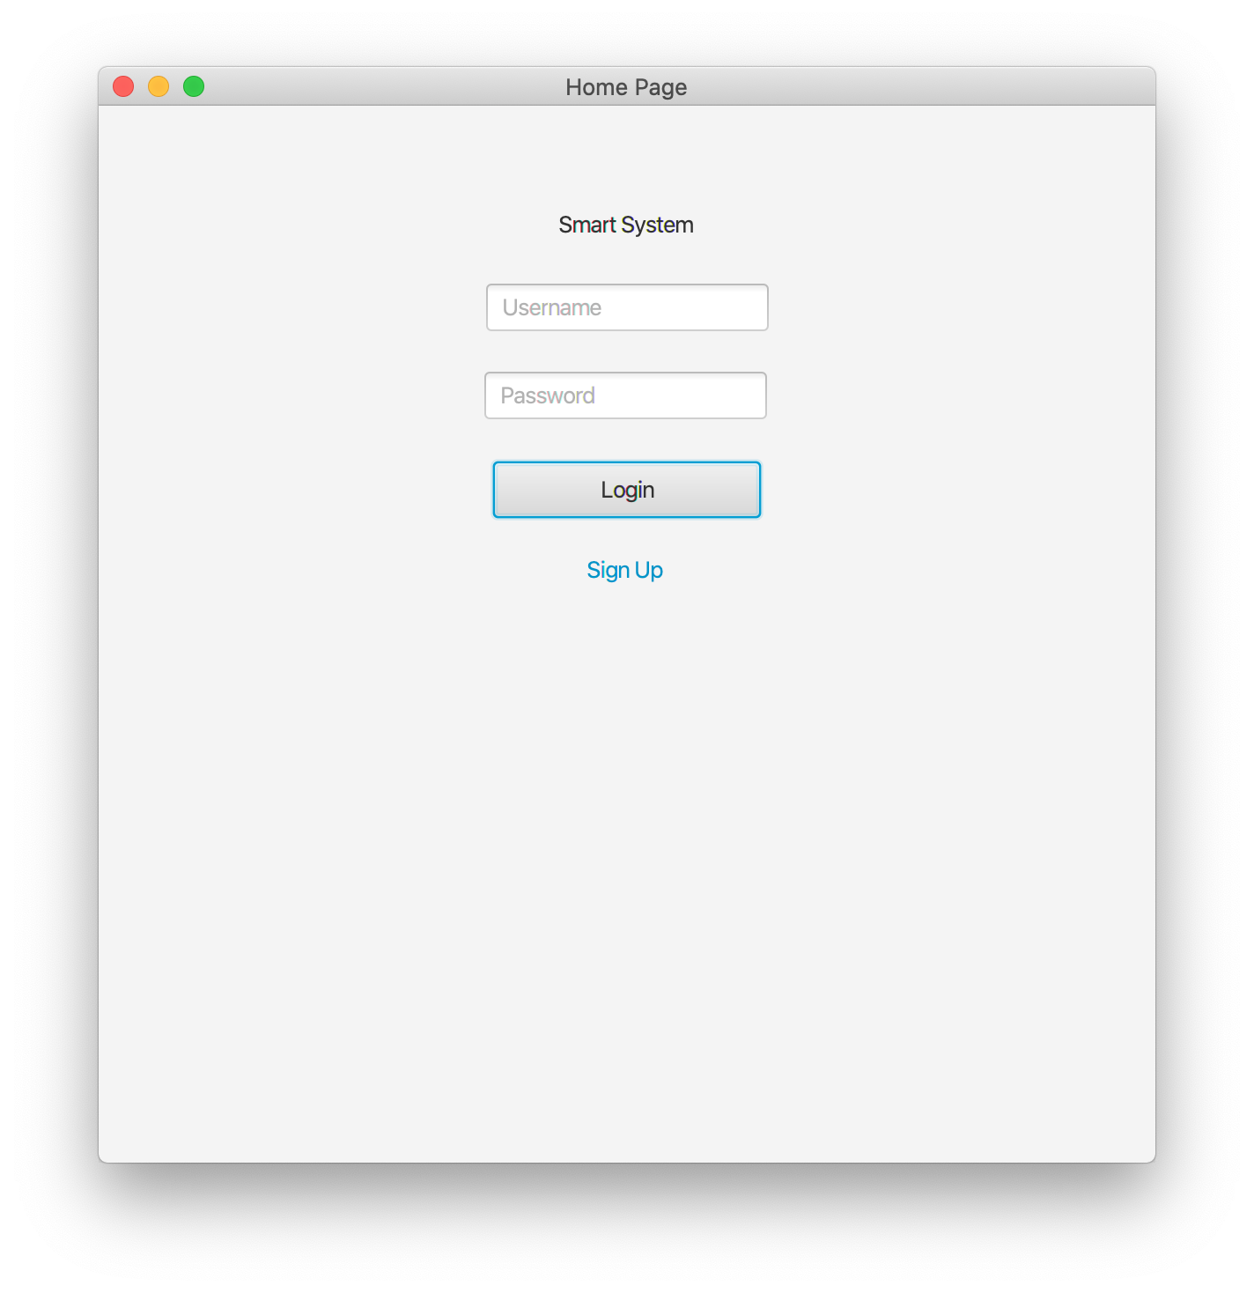
User Interface Design
Java FX -> PHP using HTML and CSS
Notes:
Mark Explains: Using the use cases and tools such as Glueon and Java Fx, I was able to create a working prototype quick and easy to give a representation of the user interface. Using this prototype as a guide the respective user interface was able to be replicated using html and css and incorporate php to enable the functionality to the user interface. The benefit of using html and css is that we created a responsive webpage so that the system could be used on monbile and desktop whilst still having the same overall appearance.

Slide 10
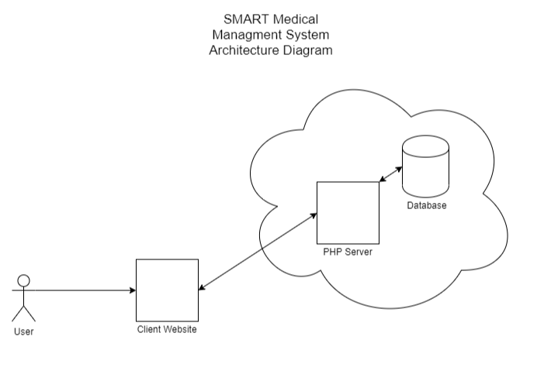
Architecture Design
Notes:
Matt Explains: Our system is using a standard PHP client server architecture with all stakeholders interacting with the same web based client. This client will then communicate with the apache server hosted in the cloud which will intern display records to the end user from the mariaDB hosted on the same cloud platform.

Slide 11
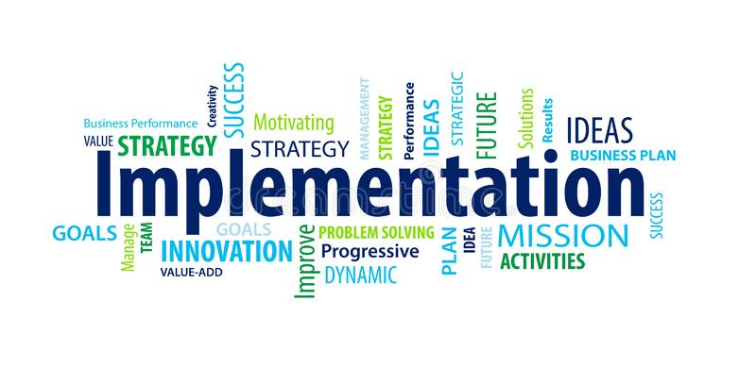
GitHub Repository
Working Project
Unit Testing
Test Plan
Notes:
At this stage our project is completely planned out and we can move on to the implementation of the project.

Slide 12
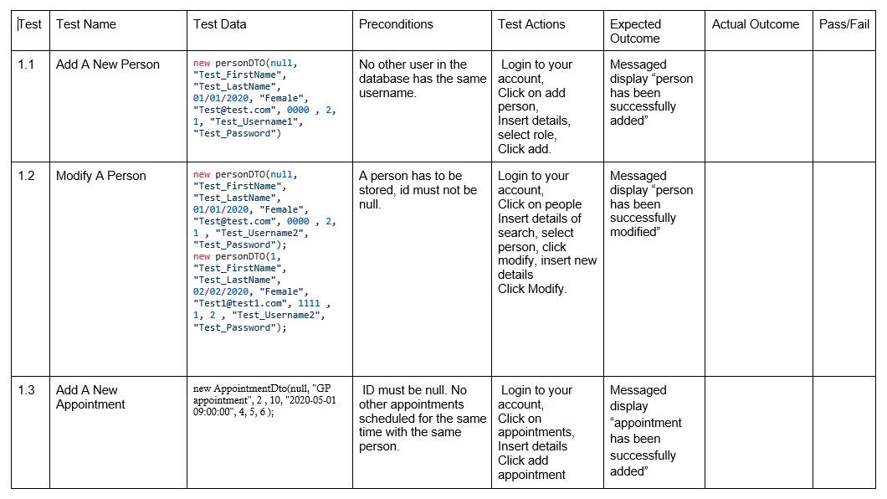
Testing

Slide 13

User Guide
Developer Guide
Notes:
A development guide has been created to provide a brief overview of what work that has taken place at each stage of the software development lifecycle. This document would be used to help onboard a new engineer or help someone taking over development understand how the system was originally created.

